Slide 1
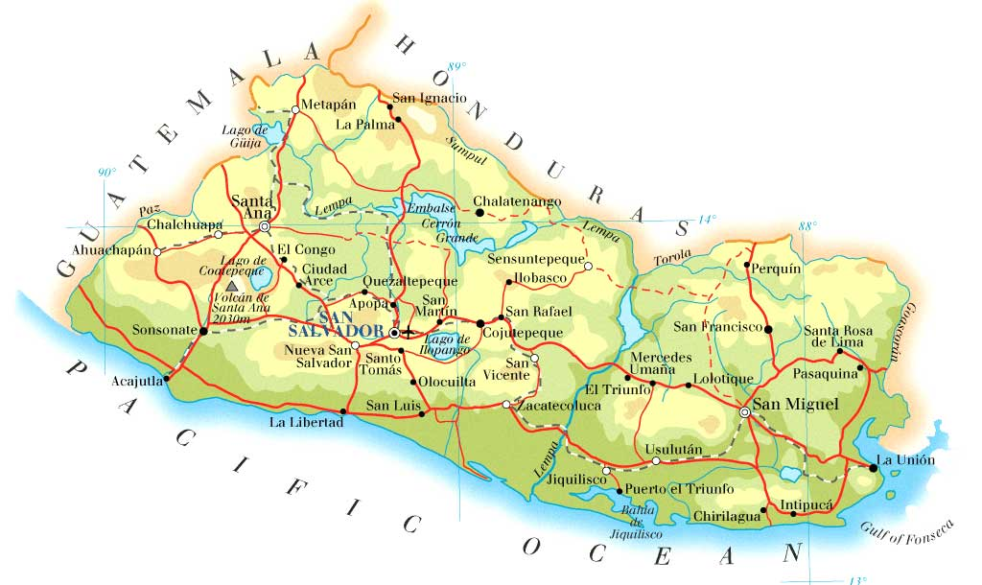

Green Truck Coffee

Slide 2

Green Truck Coffee

